Slide 1
Vertical Microphase Segregation in Polyelectrolyte Brushes:
A Systematic Study and Experimental Validation
Takashi Yokokura
PI: Prof. Rui Wang
September 14th, 10:00 am – 12:00 pm
Qualifying Exam

Slide 2
Intro

Slide 3



SCFT Build-up — System
What is the system made up of?
s
+
-
Interactions:
Elasticity (monomer-monomer)
Solubility (solvent-monomer)
Electrostatics (ion-monomer)
Assumptions:
+
-
s
+
Chains within brush identical
s
s
s
-
+
+
+
+
+
+
+
-
+
s
+
s
+
-
s
+
-
s
Ion correlations neglected
Finite ion volume neglected
s
+
+
s

Slide 4







SCFT Build-up — System
What is the end-result of the model?
111
s
+
Generate fields (equations) that all particles in the system experience
Continuous functions
Depend in a mean-field way on all other particles
“Self-consistent field theory” (SCFT)
-
+
-
s
+
s
s
s
-
+
+
+
+
+
+
+
-
+
s
+
s
+
-
111
111
+
s
-
s
s
+
+
s
(Andelman, 2006)

Slide 5





SCFT Build-up — Interactions
Goal: Adapt framework for free polyelectrolyte in solution to model end-grafted protein brushes in solution
Interactions:
Elastic entropy following Gaussian statistics
Flory-Huggins 2-body interactions
Electrostatics, ignoring any correlations
Incompressibility

Slide 6

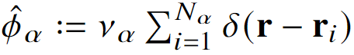
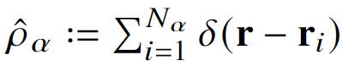




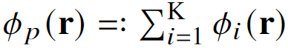
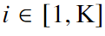
SCFT Build-up — Partition Function
Semicanonical partition function
Canonical in polymer, grand canonical in ions and solvent
Particle-to-field transformations
Hubbard-Stratonovich transformation
Saddle-point approximation
Block copolymer formalism

Slide 7







SCFT Build-up — Free Energy, SCF Eqns
Variational Free Energy
After statistical average over grafting surface (x-y plane)
Functional Minimization
SCF Equations

Slide 8
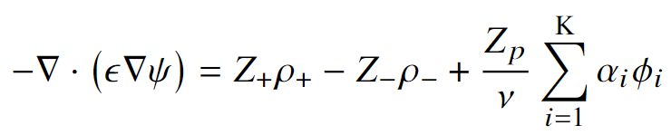

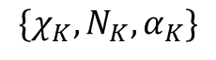
SCFT Build-up — SCF Eqns, cont.
SCF Equations, cont.
Mean-field Poisson-Boltzmann Equation
Modified Diffusion Equation
Block K
$$\{χ_{K},N_{K}, α_{K}\}$$
Block 2
Block 1

Slide 9





Homopolymer, $α=0.40$
Thresh
Minimum Free Energy Conformations
Grouped by “Conformation”
111
SCF Eqns

Slide 10



Solubility $(α$ = 0.40)

Slide 11


Solubility at Different Internal Charges

Slide 12



Internal Structure of xC conformations
Two candidates with identical averaged density profiles
2C
Stem
Neck
4Cd
“Locked-in-layer”
“Pearl-necklace-like”
(Endpoint densities x 30)

Slide 13
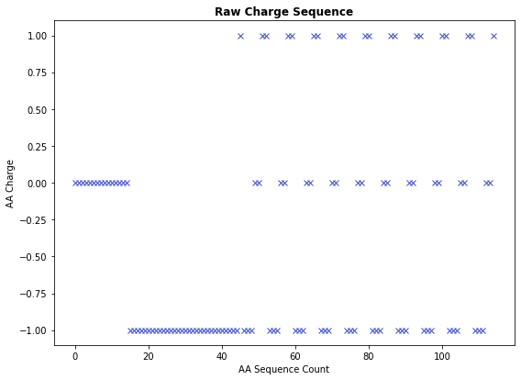
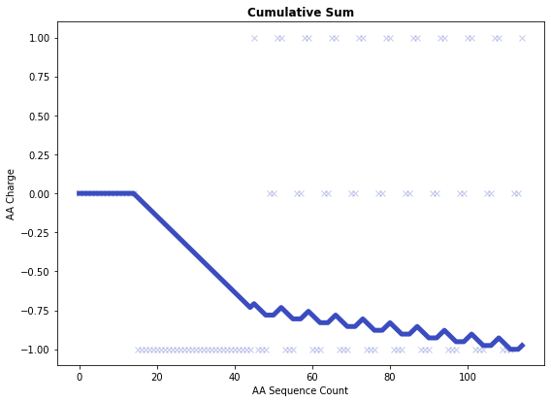
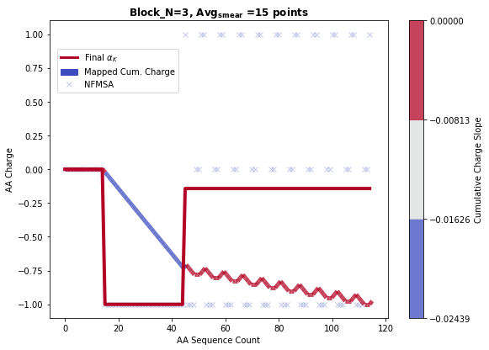
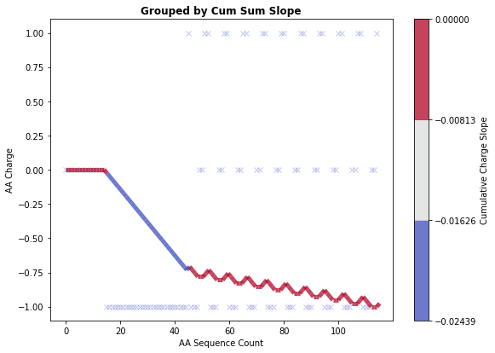
Protein Coarse-graining
Coarse-graining performed by grouping charges based on contributions to the slope of the cumulative charge
Hyperparameters: Number of bins, Minimum number of AA per block
Sample sequence:
HHHHHHHHHHHHHHH DDDDDDDDDDDDDDDDDDDDDDDDDDDDDD KDDDHHK KDDDHHK KDDDHHK KDDDHHK KDDDHHK KDDDHHK KDDDHHK KDDDHHK KDDDHHK KDDDHHK

Slide 14



Application to NFH, pH 2.4

Slide 15
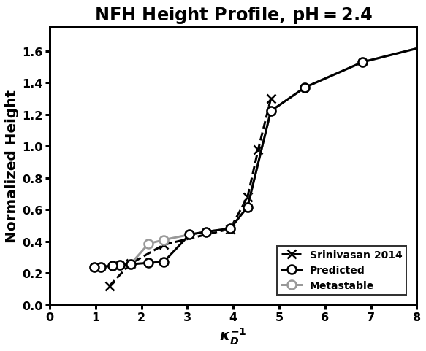

Cooperative Collapse of the Dilute Phase
What changes are occurring within NFH during 3x decrease?
Dramatic collapse
2Cd
Cooperative collapse
2C
1C

Slide 16



Reflectivity — Method
Validate results by finding layered structures in PEBs
X-ray or neutron reflectivity for characterization of layered films
Specular part of wave momentum transfer vector
Master Equation: Relates density changes to momentum transfer

Slide 17
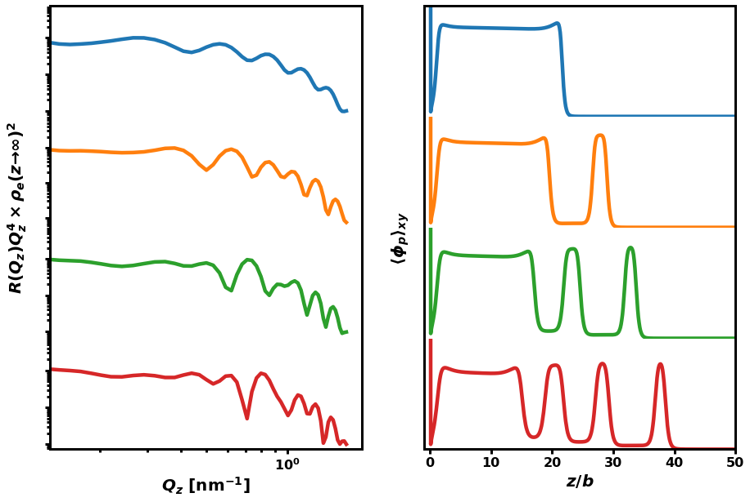

Reflectivity — Characteristic Spectra
X-ray and neutron reflectivity
Direct information on polymer internal structure
Prior knowledge of possible conformations necessary
Master Equation
(Reinhardt, et. al. Macromolecules, 2013)

Slide 18
Future Work

Slide 19
Summary

Slide 20
Acknowledgements

Slide 21
Summary
Paste from above

Slide 22
SI: Table of Contents
References
SCFT Build-up
Flowchart

Slide 23
References

Slide 24





SCFT Build-up — Flowchart
PDE Solve (for iteration k)
Propagate (using PDE solutions)
Check (for self-consistency)
Update (if not satisfied)
Anderson Mixing
Simple Mixing
Notation slightly incorrect but changed for clarity. w^{k} = f(w^{k+1/2}, w^{k-1}), where w^{k+1/2} is from SCFT calculations (\phi remains ^{k})

Slide 25
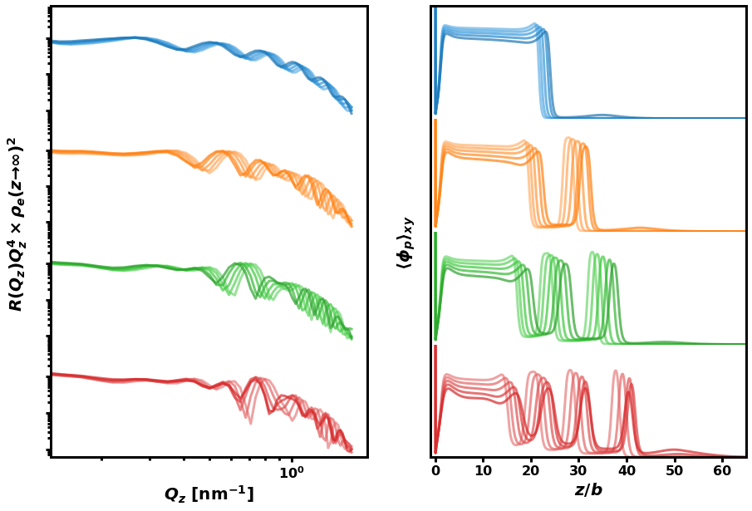

Reflectivity — Different $χ$’s

